Slide 1
Basics of JDBC

Slide 2
Overview
What is JDBC?
Why need an application other than DBMS?
How JDBC can help?
JDBC Steps
Transactions in JDBC
JDBC Drivers
Summary

Slide 3
What is JDBC?
JDBC is: a Sun trademark
  is often taken to stand for Java Database Connectivity.
  is a Java API for connecting programs written in Java to the data in relational databases.
  consists of a set of classes and interfaces written in the Java programming language.
  provides a standard API for tool/database developers and makes it possible to write database applications using a pure Java API.
  The standard defined by Sun Microsystems, allowing individual providers to implement and extend the standard with their own JDBC drivers.
Notes:
JDBC is the standard for portable access to relational databases from within the Java language.
JDBC is based on the X/Open SQL Call Level Interface, and complies with the SQL92 Entry Level standard.
JDBC specifies a set of object-orient programming classes for the programmer to use in building SQL requests. An additional set of classes describes the JDBC driver API. The most common SQL data types, mapped to Java data types, are supported. The API provides for implementation-specific support for transactional requests and the ability to commit or roll back to the beginning of a transaction.

Slide 4
JDBC
Java is very standardized, but there are many versions of SQL
JDBC is a means of accessing SQL databases from Java
  JDBC is a standardized API for use by Java programs
  JDBC is also a specification for how third-party vendors should write database drivers to access specific SQL versions
JDBC:
  establishes a connection with a database
  sends SQL statements
  processes the results.

Slide 5
The need of an application
Databases offer structured storing, easy retrieval and processing of data
The maintenance, however, can be tedious
Suppose you manage a database store on an SQL server. Then you need to have a knowledge on SQL in order to retrieve or update data. This will not be that pleasant for you. Will it?
An application in between can do the job for you
The application will deal with the database while you interact with the user-friendly GUI

Slide 6
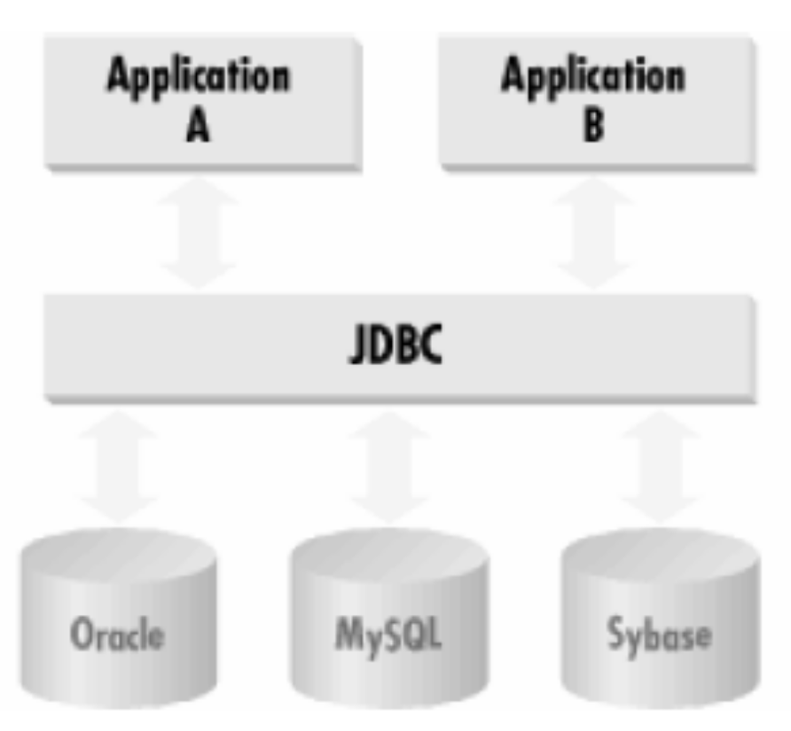
JDBC
Java Database Connectivity
Provides a Java API to access SQL databases

Slide 7
The JDBC API
The JDBC API contains methods to communicate with DBMS or RDBMS
The JDBC API uses the JDBC driver to carry out it tasks
The JDBC API & Driver enables a Java application to:
1. Establish a connection with a data source
2. Send queries and update statements to the data source
3. Process the results
Java Program
JDBC API
JDBC Driver
Database
The process of accessing the database

Slide 8
JDBC API
The JDBC API supports both two-tier and three-tier models for database access.
Two-tier model -- a Java applet or application interacts directly with the database.
Three-tier model -- introduces a middle-level server for execution of business logic:
  the middle tier to maintain control over data access.
  the user can employ an easy-to-use higher-level API which is translated by the middle tier into the appropriate low-level calls.

Slide 9
The JDBC API
The JDBC API supports both two-tier and three-tier models
Java applet or HTML browser
Client machine (GUI)
Java Application
Client machine
HTTP, RMI, CORBA or other calls
JDBC
Application server (Java)
DBMS – proprietary protocol
Server machine
(business logic)
JDBC
Database server
DBMS – proprietary protocol
DBMS
Database server
DBMS
Two-tier model
Three-tier model

Slide 10
JDBC Classes
java.sql.
  DriverManager
    getConnection
  Connection
    createStatement
  Statement
    execute, executeQuery, executeBatch, executeUpdate
  ResultSet
    next, getString, getInt, getDate, getMetaData
  ResultSetMetadata
    getColumnCount, getColumnName, getColumnType

Slide 11
JDBC Steps
Instantiate proper driver
2. Open connection to database
3. Connect to database
4. Query database (or insert/update/delete)
5. Process the result
6. Close connection to database

Slide 12
1. Instantiate Driver
Class.forName(“driver class”)
Driver class is vendor dependent, e.g.,
  sun.jdbc.odbc.JdbcOdbcDriver
    JDBC-ODBC bridge used to access ODBC Sources
  com.mysql.jdbc.Driver
    driver to access MySQL database
  com.sybase.jdbc2.jdbc.SybDriver
    driver to access Sybase database

Slide 13
2. Open Connection
DriverManager.getConnection(url)
or
DriverManager.getConnection(url, user, pwd) return Connection
URL is jdbc:<subprotocol>:<subname>
  e.g., jdbc:odbc:someDB
jdbc:<subprotocol>://<host>:<port>/<db>
  jdbc:mysql://localhost:3306/testDB

Slide 14
3. Connect to database
Load JDBC driver
  Class.forName("com.mysql.jdbc.Driver").newInstance();
Make connection
  Connection conn = DriverManager.getConnection(url);
URL
  Format: jdbc:<subprotocol>://<host>:<port>/<db>
  jdbc:mysql://localhost:3306/testDB

Slide 15
4. Query database
Create statement
  Statement stmt = conn.createStatement();
  stmt object sends SQL commands to database
  Methods
    executeQuery() for SELECT statements
    executeUpdate() for INSERT, UPDATE, DELETE, statements
Send SQL statements
  stmt.executeQuery(“SELECT …”);
  stmt.executeUpdate(“INSERT …”);

Slide 16
5. Process results
Result of a SELECT statement (rows/columns) returned as a ResultSet object
  ResultSet rs = stmt.executeQuery("SELECT * FROM users");
Step through each row in the result
  rs.next()
Get column values in a row
  String userid = rs.getString(“userid”);
  int type = rs.getInt(“type”);
users table
userid | firstname | lastname | password | type
Bob | Bob | King | cat | 0
John | John | Smith | pass | 1

Slide 17
Print the users table
ResultSet rs = stmt.executeQuery("SELECT * FROM users");
while (rs.next()) {
String userid = rs.getString(1);
String firstname = rs.getString(“firstname”);
String lastname = rs.getString(“lastname”);
String password = rs.getString(4);
int type = rs.getInt(“type”);
System.out.println(userid + ” ” + firstname + ” ” + lastname + ” ” + password + ” ” + type);
}
users table
userid | firstname | lastname | password | type
Bob | Bob | King | cat | 0
John | John | Smith | pass | 1

Slide 18
Add a row to the users table
String str = "INSERT INTO users VALUES('Bob', 'Bob', 'King',
'cat', 0)”;
//Returns number of rows in table
int rows = stmt.executeUpdate(str);
users table
userid | firstname | lastname | password | type
Bob | Bob | King | cat | 0

Slide 19
6. Closing connections
Close the ResultSet object
  rs.close();
Close the Statement object
  stmt.close();
Close the connection
  conn.close();

Slide 20
import java.sql.*;
public class Tester {
public static void main(String[] args) {
try {
// Load JDBC driver
Class.forName("com.mysql.jdbc.Driver");
// Make connection
String url = “jdbc:mysql://localhost:3306/testDB”;
Connection conn = DriverManager.getConnection(url, ”root”, ”rev”);
// Create statement
Statement stmt = conn.createStatement();
// Print the users table
ResultSet rs = stmt.executeQuery("SELECT * FROM users");
while (rs.next()) {
...
}
// Cleanup
rs.close(); stmt.close(); conn.close();
}
catch (Exception e) {
System.out.println("exception " + e);
}
}

Slide 21
Transactions
Currently every executeUpdate() is “finalized” right away
Sometimes want to a set of updates to all fail or all succeed
  E.g. add to Appointments and Bookings tables
  Treat both inserts as one transaction
Transaction
  Used to group several SQL statements together
  Either all succeed or all fail

Slide 22
Transactions
Commit
  Execute all statements as one unit
  “Finalize” updates
Rollback
  Abort transaction
  All uncommited statements are discarded
  Revert database to original state

Slide 23
Transactions in JDBC
Disable auto-commit for the connection
  conn.setAutoCommit(false);
Call necessary executeUpdate() statements
Commit or rollback
  conn.commit();
  conn.rollback();

Slide 24
JDBC Driver
There are four flavors of JDBC
JDBC-ODBC Bridge (Type 1 driver)
Native-API/partly-Java driver (Type 2 driver)
Net-protocol/all-Java driver (Type 3 driver)
Native-protocol/all-Java driver (Type 4 driver)

Slide 25
JDBC Driver
We will use the,
Native-protocol/all-Java driver
Java Application
Native-protocol/all-Java driver
Database server
Functionality of Type 4 driver

Slide 26
On The Job
Required software
Java-2 JVM s including JDK – 1.4x or newer to compile
MySQL server version 4.1 or newer
MySQL Connector/J
Note: We have used MySQL as the database server and MySQL Connector/J as the database specific JDBC driver

Slide 27
Example
import java.sql.*;
import java.io.*;
class JDBC
{
public static void main(String[] args)
{
try
{
Connection conn;
Statement stmt;
String Query;
ResultSet rs;
Class.forName("com.mysql.jdbc.Driver");
conn=DriverManager.getConnection("jdbc:mysql://localhost/game","root","password");
stmt=conn.createStatement();

Slide 28
Query="select * from table1";
rs=stmt.executeQuery(Query);
while(rs.next())
{ String s = rs.getString(1);
System.out.println(s);
}
rs.close();
conn.close();
}
catch(SQLException sqle)
{
System.out.println(sqle);
}
catch(Exception e)
{
System.out.println(e);
}
}
}

Slide 29
Loading the Driver
a) Import statements
import java.sql.*;
b) Loading the database driver
Class.forName("com.mysql.jdbc.Driver");
- We load the driver class by calling Class.forName() with the Driver
class name as an argument
- If the class name is jdbc.DriverXYZ , you would load the driver with the
following line of code: Class.forName("jdbc.DriverXYZ");
- Once loaded, the Driver class creates an instance of itself.

